Slide 1
Climate change Bangladesh part
WELCOME TO OUR PRESENTATION
Course Title : Bangladesh studies
Course Code : GED-121
Course Teacher : Mr. Abu Musa

Slide 2





Meet Our Team
Amit kumar Ghosh
Mehedi Hasan
Motasem Billah Asik
Rafi Ferdos
Al Amin
Serial-1
Serial-2
Serial-3
Serial-4
Serial-5

Slide 3
Table of contents
People are forced to Mitigation &
Learn to adapted in new Climate
Introduction
Climate and Climate change
Effect of climate change on Bangladesh
Impacts on the natural environment
Weather change & Temperature, sea level rise
Impacts on people
People’s life-style is changing due
To Climate change
Mitigation and adaptation
Society and culture
Climate plays a huge role
on our Culture & Society
Natural Disaster due to Climate change

Slide 4
Climate change is no longer some far-off problem; it is happening here, it is happening now.
“
”
Barack Obama

Slide 5
Introduction
What is climate & Climate change?
the weather conditions prevailing in an area in general or over a long period. Climate change refers to long-term shifts in temperatures and weather patterns.

Slide 6

Effect of climate change on Bangladesh
E
Climate change in Bangladesh is a critical issue as the country is one of the most vulnerable to the effects of climate change.
it ranked seventh in the list of countries most affected by climate calamities during the period 1999–2018.
Bangladesh's vulnerability to climate change impacts is due to a combination of geographical factors, such as
its flat, low-lying, and delta-exposed topography, and socio-economic factors, including its high population density, levels of poverty, and dependence on agriculture.
Almost every year large regions of Bangladesh suffer from more intense events like cyclones, floods and erosion.
Natural hazards that come from increased rainfall, rising sea levels, and tropical cyclones are expected to increase
as the climate changes, each seriously affecting agriculture, water and food security, human health, and shelter.

Slide 7

Impacts on the natural environment
I
1. Temperature and weather changes :
Climate change increasing the average temperature of the earth’s atmosphere because an increased amount of the energy (heat) striking the earth from the sun is being trapped in the atmosphere and not radiated out into space.
2. Sea level rise :
Sea levels in Bangladesh are predicted to rise by up to 0.30 meter's by 2050, resulting in the displacement of 0.9 million people,
and by up to 0.74 meter's by 2100, resulting in the displacement of 2.1 million people.

Slide 8
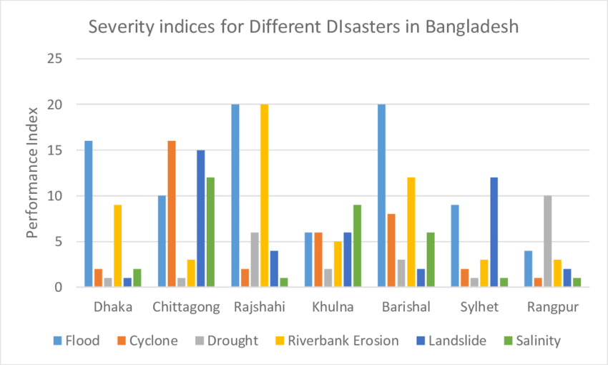
Quarterly performance

Slide 9
Impacts on people
I
Economic impacts :
The economic impacts of climate change vary geographically and are difficult to forecast exactly. Researchers have warned that current economic, may seriously underestimate the effects of climate change and point to the need for new models that give a more accurate picture of potential damages.
2. Agriculture :
Climate change can disrupt food availability, reduce access to food, and affect food quality. For example, projected increases in temperatures, changes in precipitation patterns, changes in extreme weather events, and reductions in water availability may all result in reduced agricultural productivity.
Impacts on migration :
Climate change, an increasingly potent driver of migration, continue to compel millions of people to leave their homes every year. The latest Groundswell report¹ released by the World Bank finds that climate change could force 216 million people across six world regions² to move within their countries by 2050

Slide 10
Mitigation and adaptation
M
1. Adaptation :
In essence, adaptation can be understood as the process of adjusting to the current and future effects of climate change. Mitigation means making the impacts of climate change less severe by preventing or reducing the emission of greenhouse gases (GHG) into the atmosphere.
International cooperation :
Climate change is very likely to affect global, regional, and local food security by disrupting food availability, decreasing access to food, and making utilization more difficult. Climate risks to food security are greatest for poor populations and in tropical regions.

Slide 11
Society and culture
I
Women :
Climate change deepens existing inequalities. That's because women are more likely to live in poverty than men, have less access to basic human rights like the ability to freely move and acquire land, and face systematic violence that escalates during periods of instability.
2. Media :
The fact that we are experiencing levels of carbon dioxide in the atmosphere that haven't been seen in millions of years and never before in human history is mentioned in only 1% of the paper's articles. And the fact that climate change is permanent is mentioned in only 0.4% of articles.
3. Civil society :
This chapter focuses on the efforts of social movement organizations and civil society more broadly in advocating for action on climate change. Social movements have historically been and continue to be major forces for the types of broad-scale reforms required to address problems of this magnitude.

Slide 12
Summary
At First we introduced you to Climate and what is climate change then
We explained the Effects of climate change on Bangladesh then
We talked about the Impact of climate change on our Environment and
how Climate effects our day-to-day lifestyle and how people had to adapted
With new Climate, then finally we talked about how Climate change effects
Our Society and Cultural life.

Slide 13
Thank You
References​ :
https://en.wikipedia.org/wiki/Climate_change_in_Bangladesh
https://en.wikipedia.org/wiki/Economic_impacts_of_climate_change
https://warmheartworldwide.org/what-is-globalwarming/?gclid=EAIaIQobChMIsKLKrqiuwIV0H8rCh2SPQEZEAAYAiAAEgLtzvD_BE

